Slide 1

WAY TO ENTERPRISE
AWS
VTI ACADEMY
Author: duy.nguyenngoc1@vti.com.vn

Slide 2
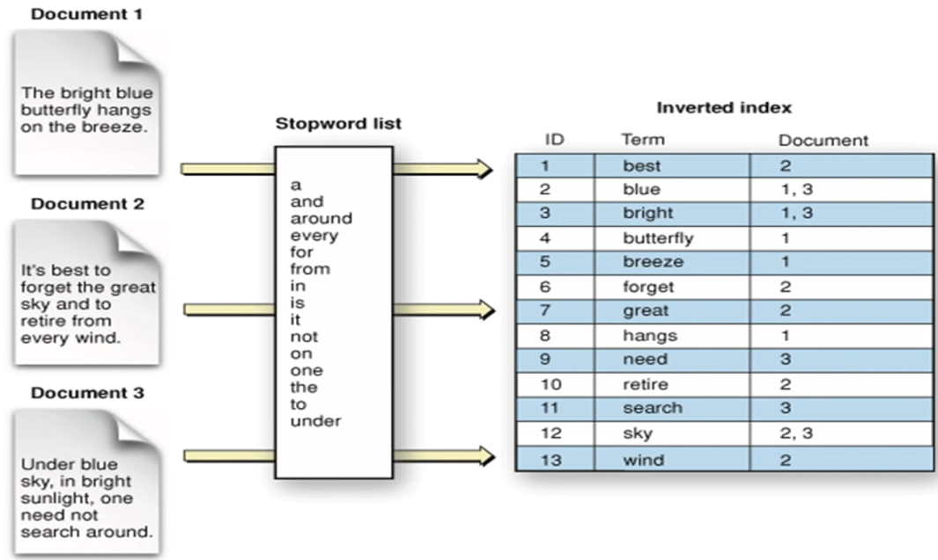
ElasticSearch Service
Is a distributed search and analytics engine built on Apache Lucene
You can search any field (in DynamoDB, you can only find by primary key / indexes)
Using Inverted index for full-text search
Full-text search Tutorial

Slide 3
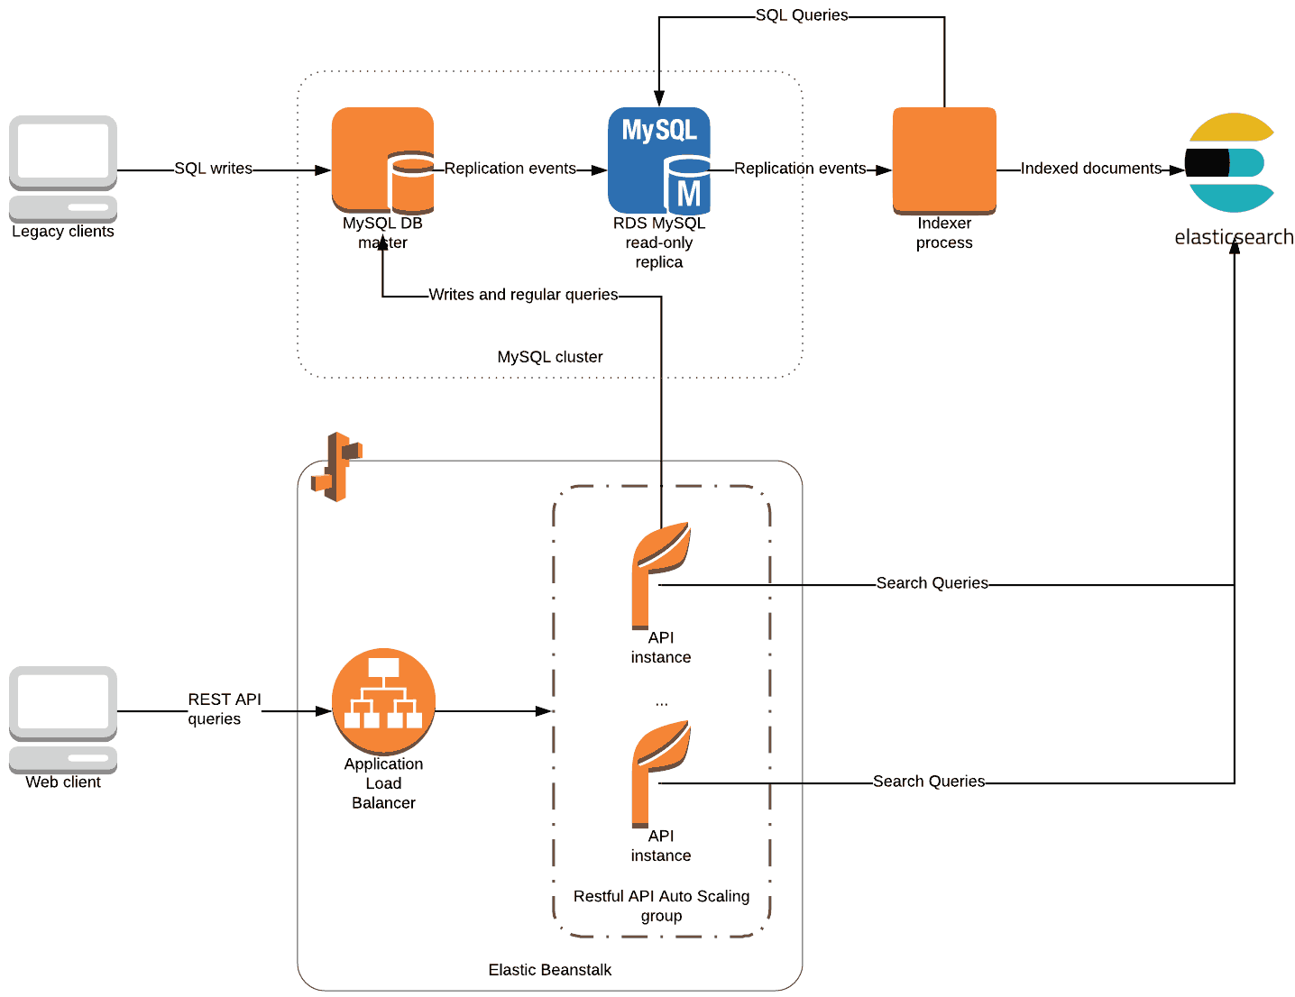
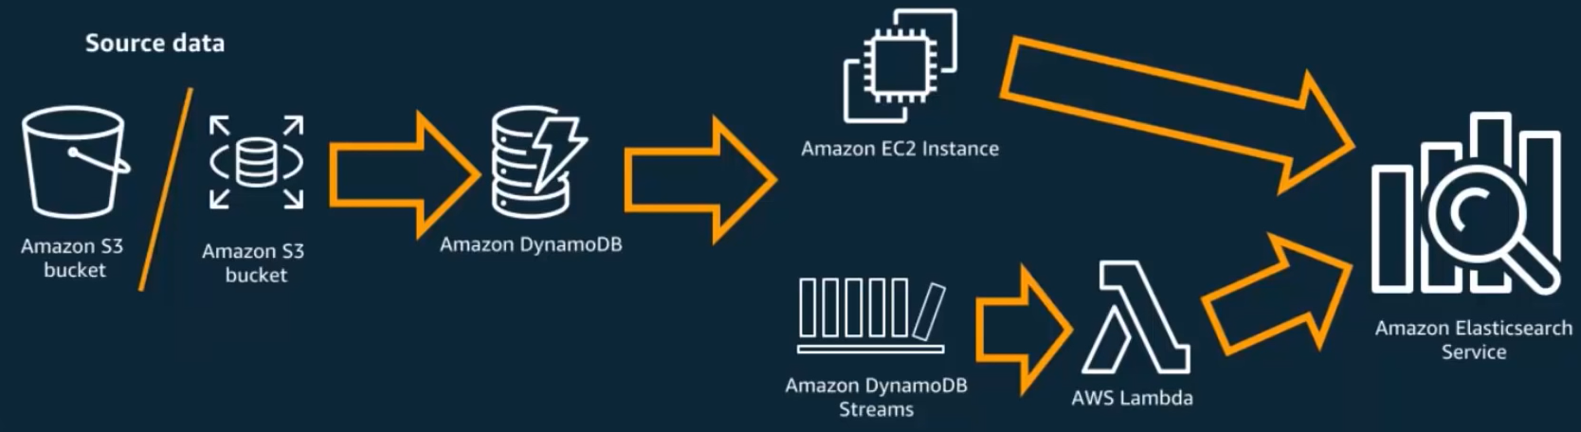
ElasticSearch Service
Designed for search purposes 🡺 poor performance for CRUD task and not support database transaction 🡺 rarely use ElasticSearch as the main database, but often combine it with another database (MySQL, DynamoDB, ...)
DynamoDB + ElasticSearch
MySQL + ElasticSearch

Slide 4
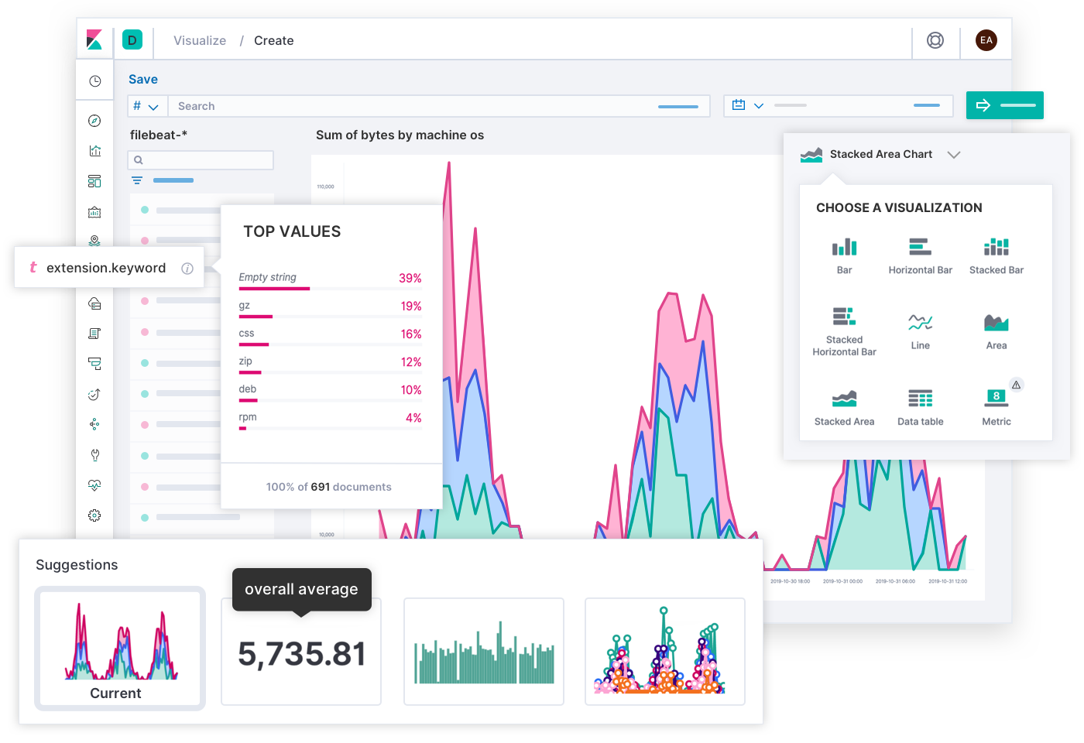
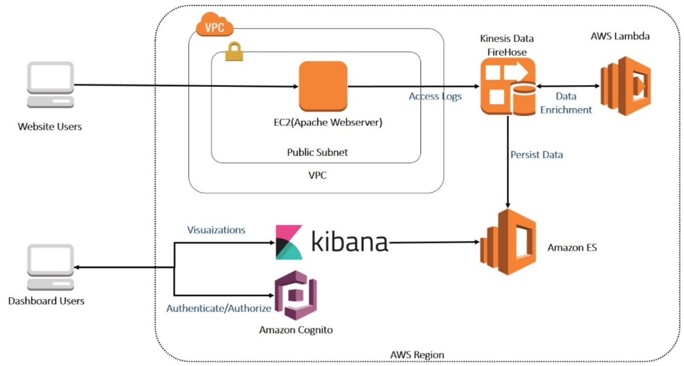
ElasticSearch Service
Integrates with Kinesis Data Firehose, AWS IoT, CloudWatch Logs for data ingestion
Visualize data via Kibana / Ingest log via Logstash / Accessing via HTTP Rest API & JSON format
Kibana

Slide 5
ElasticSearch Service
Open source, Near real-time
Horizontal scalability
Usecases
  Log analytics
  Full-text search
Price: https://aws.amazon.com/opensearch-service/pricing
https://docs.aws.amazon.com/opensearch-service/latest/developerguide/what-is.html

Slide 6
ElasticSearch Service
Demo
  ElasticSearch
    Rest API: https://www.youtube.com/watch?v=KXrupsR9aHo
    Kibana: https://www.youtube.com/watch?v=mWRo_JVgP_0
  DynamoDB + ElasticSearch: https://www.youtube.com/watch?v=BET2gaoz8Vo
  MySQL + ElasticSearch: https://www.youtube.com/watch?v=62E3hAx_G9c

Slide 7
Assignment
  Self-practice

Slide 8

OpenSearch Service
Is a new version of ElasticSearch
What’s changed?
  API version (CreateElasticsearchDomain changed to CreateDomain)
  Renamed Instance types, CloudWatch metrics
  Access policy changes
  New resource types
  Kibana renamed to OpenSearch Dashboards
  Renamed Billing and Cost Management console changes

Slide 9
OpenSearch Service
Demo
  https://www.youtube.com/watch?v=XqQJmV2yoks

Slide 10
Assignment
  Self-practice

Slide 11
Summary
OpenSearch (ElasticSearch) is a distributed search and analytics engine built on Apache Lucene
You can search any field, using Inverted index for full-text search
Rarely use ElasticSearch as the main database, but often combine it with another database (MySQL, DynamoDB, ...)
Support Visualize data, ingest log, accessing via HTTP Rest API & JSON format
Open source, Near real-time, Horizontal scalability
Usecases: Log analytics, Full-text search
OpenSearch is a new version of ElasticSearch

Slide 12
Q & A
Copyright © VTI Academy All Rights Reserved

